Slide 1
STREAM ANALYSIS FOR CAREER CHOICE
APTITUDE TESTS
SANA VK
MCA S6
ROLL No:26
TCR19MCA022
GUIDED BY
HUSSAIN AHAMED

Slide 2
Problem definition
Most of the users are confused while selecting their streams according to their capability
User can select career choice based on their IQ.
The main aim of the project is to help user for choosing their career option.
System helps the user to select their career choice according to their interest in particular field.
Users attend exams and the score in these exams are considered to recommend streams

Slide 3
Existing system
In existing system, students learn about various courses from many sources, such as advertisements, internet, friends etc.
But they may be confused to choose from this list as it may contain a lot of courses.
Students tend to choose courses with less fee structure. In most cases, students do not opt for courses that match their skills.

Slide 4
disadvantages of the existing system
Students get confused in choosing their career streams.
Due to various reasons students choose streams that do not match their skills.

Slide 5
proposed SYSTEM
In our proposed system, we conduct tests or exams.
Registered candidates can attend these exams.
On completion of the exam, their score is updated to the server.
Based on their score counsellors can recommend them to agencies.
Thus the students get recommendation of courses.

Slide 6
advantages of our proposed system
Students get recommendation based on their expertise in various areas.
Due to the recommendation from agencies, students do not have much confusions compared to existing system

Slide 7
MODULES
1. ADMIN.
2. STUDENT.
3. COUNSELLOR.
4. AGENCY

Slide 8
admin
Login
Course management
Main stream management
Sub stream management
Question management
View student details
View result
View and approve counsellor
View approved counsellors
View and approve agency
View approved agency

Slide 9
STUDENT
Registration
Login
View profile
View course
View main stream
View sub stream
Attend exam
View result
Chat with counsellor
View agency
Chat with agency

Slide 10
COUNSELLOR
Registration
Login
View profile
View students
View performance
Chat with students
Notify agencies about candidates

Slide 11
AGENCY
Registration
Login
View profile
Manage course details
View recommended candidates
Manage admission of candidates
Chat with students

Slide 12
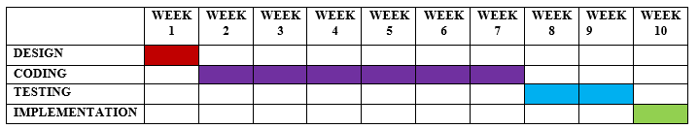
GANTT CHART

Slide 13
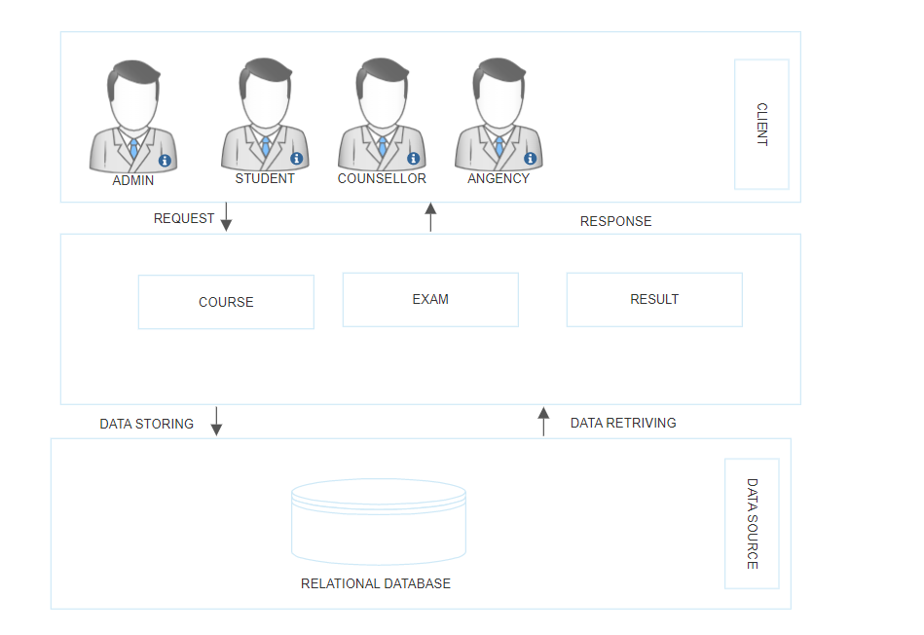
ARCHITECTURE DIAGRAM

Slide 14
Data flow diagram (dfd)

Slide 15
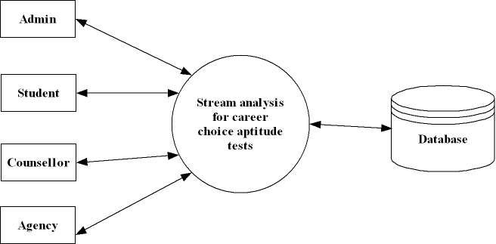
Level 0

Slide 16
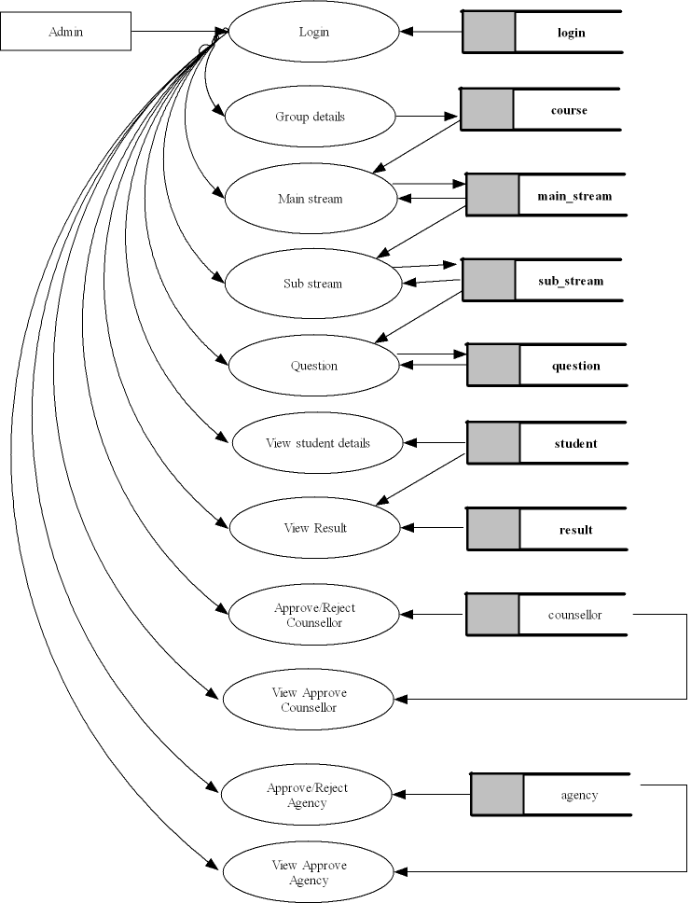
Level 1

Slide 17
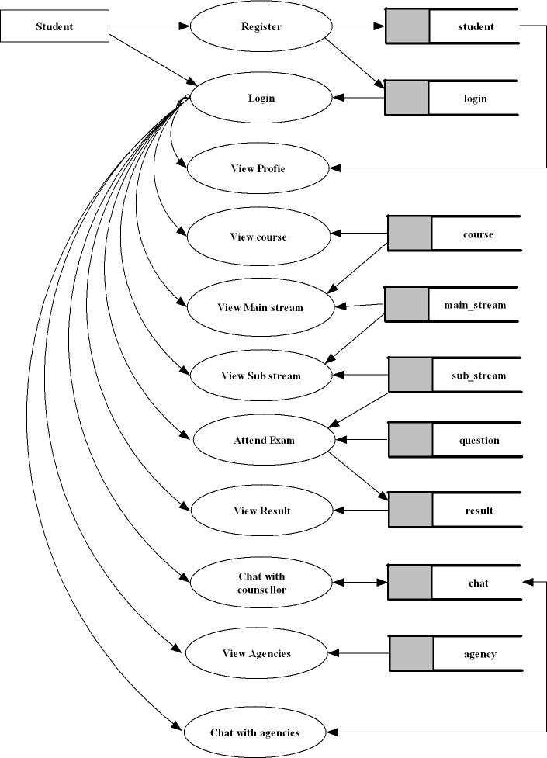
Level 2

Slide 18
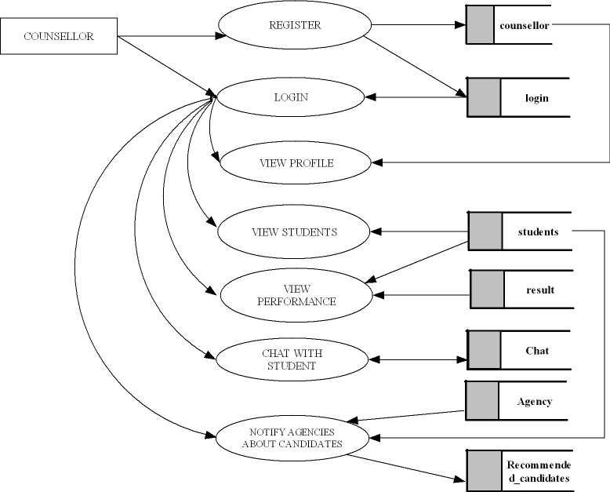
Level 3

Slide 19
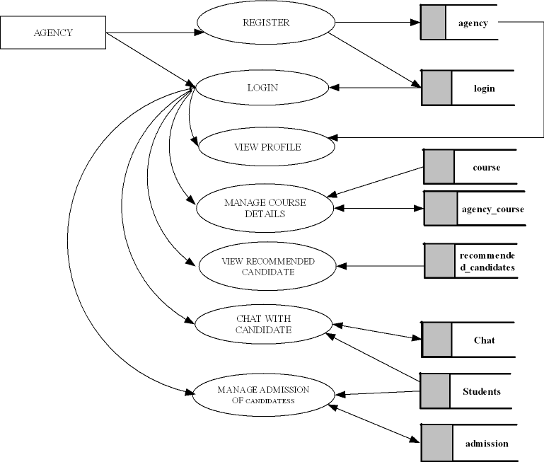
Level 4

Slide 20
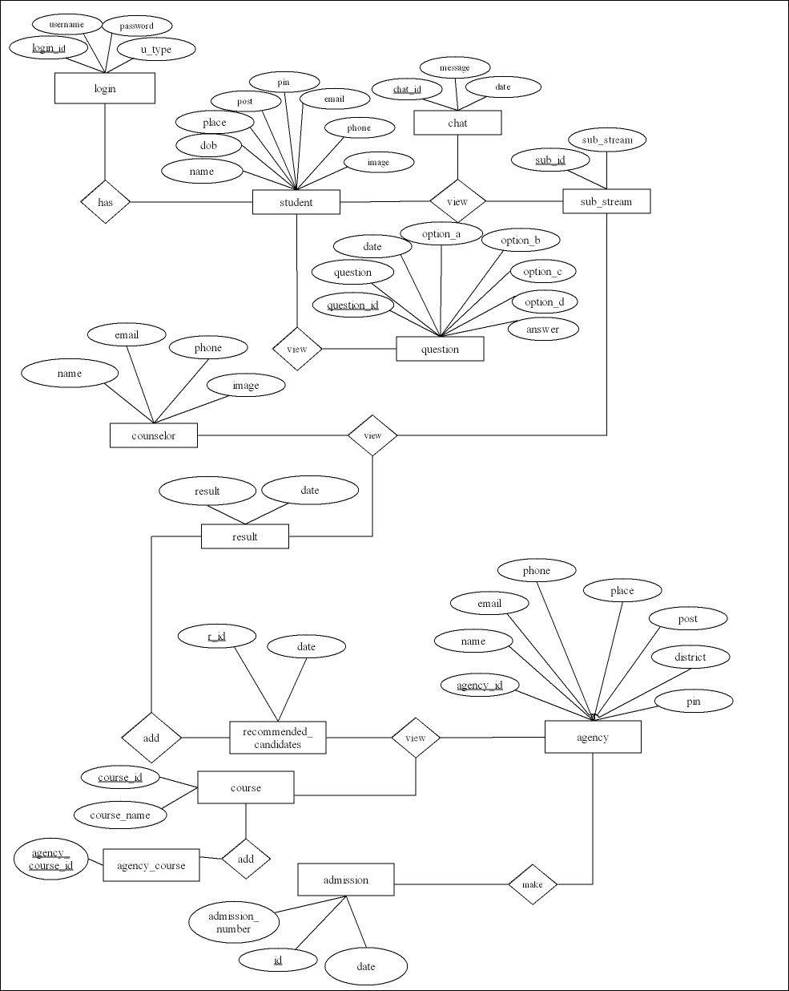
Er diagram

Slide 21
REQUIREMENTS
SOFTWARE REQUIREMENTS
Operating System : Windows 8 or above
Front End : HTML, CSS, JavaScript
Back End : Python ,Android, MySQL
IDE : JetBrains, Pycharm,Android Studio
Framework : Flask
HARDWARE REQUIREMENTS
Processor : Intel Core i3 or above
Hard Disk Space : 320 GB
Memory : 4 GB RAM or above
Keyboard : 104 keys

Slide 22
CONCLUSION
The advantage of the system over existing system was the lack of confusion in choosing courses from given set. In existing system, students get confused while choosing from a lot of courses, which may result in choosing courses that do not match their skills. The proposed system proves to be very helpful for students in choosing courses that suit their skills.

Slide 23
THANK YOU

